Slide 1
CSCI B565 - Data Mining
Movie Rating Prediction
Shardul Dabhane
Mohit Dalvi

Slide 2
Motivation
As a group, we are huge movie fanatics and enjoy great films such as Fight Club, The Departed , and any Nolan flick.
As data mining students we wanted to dig deeper into what influences the ratings of a movie on IMDB.

Slide 3
Problem Statement
To predict the rating of a movie on IMDB based on attributes like Runtime, Metascore, etc. with the help of various supervised Machine Learning algorithms.
To do a comparative study of the results of those Machine Learning algorithms.

Slide 4
Dataset
The dataset consists of features like Rank, Title, Genre, Description, Director, Actors, Year, Runtime(Minutes), Rating, Votes, Revenue and Metascore.
The dataset consists of 1000 movies from the years 1996 to 2006.

Slide 5
Steps to solve Problem
EDA
Data Preprocessing
Feature Engineering
Modelling and hyperparameter tuning.

Slide 6
Regression Algorithms Used
Linear Regression
K-Nearest Regressor
Random Forest Regressor

Slide 7
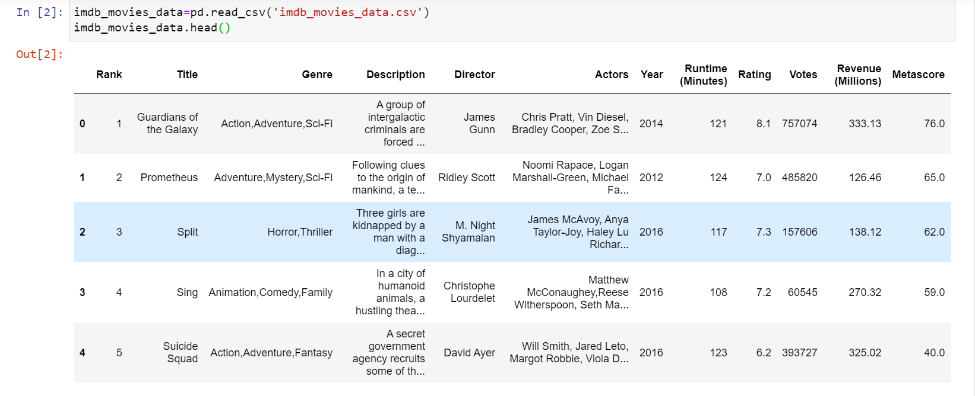
Dataset

Slide 8
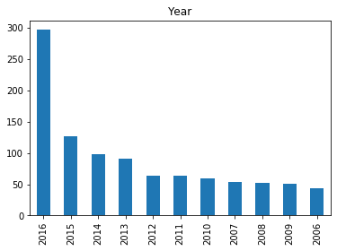
EDA
Bar Plot for movies by year

Slide 9
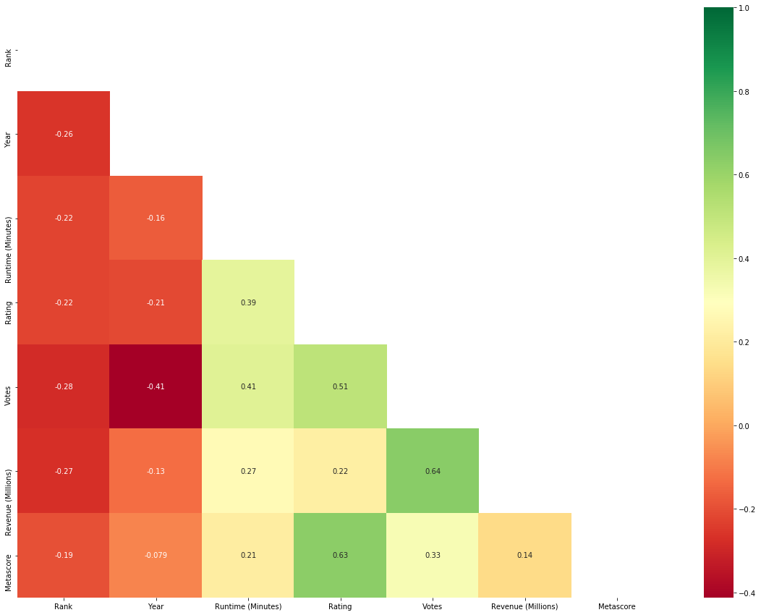
EDA
HeatMap(Correlation)

Slide 10
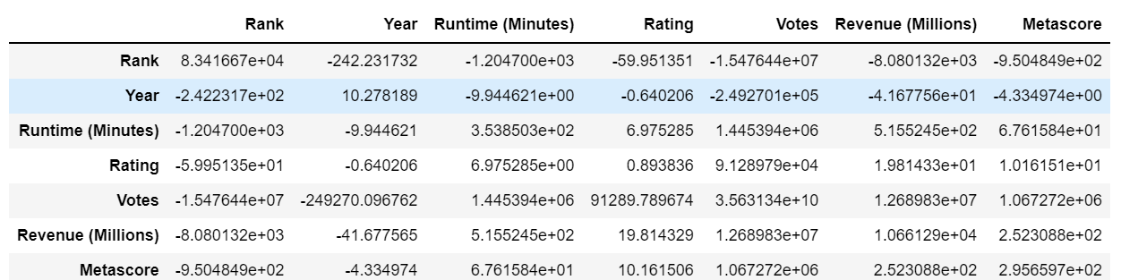
EDA
Covariance

Slide 11
Data Preprocessing Steps
Using one-hot encoding on categorical attributes like 'Title', 'Genre', 'Description', 'Director' and ‘'Actors'.
Missing Values Imputation

Slide 12
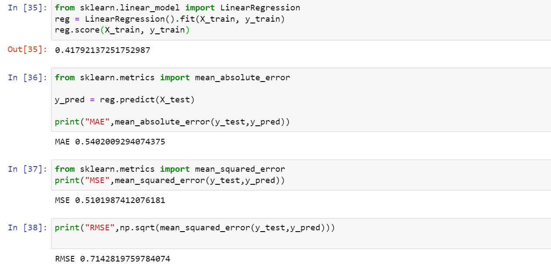
Initial Results of Linear Regression

Slide 13
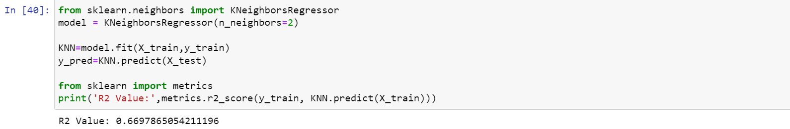
Initial Results for K-Nearest Regression

Slide 14
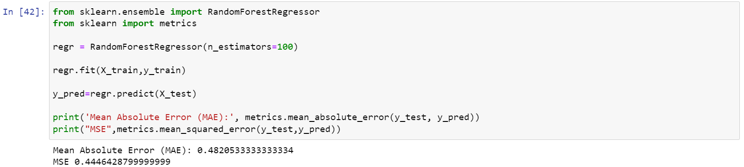
Initial Results for Random Forest Regression

Slide 15
Current and Future Scope
Feature Engineering.
Feature Selections and Importance.
Using Cross validation to improve model accuracy.

Slide 16
References
Dataset Source:
https://www.kaggle.com/datasets/PromptCloudHQ/imdb-data
Awan, M.J.; Khan, R.A.;Nobanee, H.; Yasin, A.; Anwar, S.M.;Naseem, U.; Singh, V.P. A Recommendation Engine for Predicting Movie Ratings Using a Big Data Approach. Electronics 2021, 10, 1215. https://doi.org/10.3390/electronics10101215.
Mhowwala, Zahabiya & Razia, A. & D., Sujala. (2020). Movie Rating Prediction using Ensemble Learning Algorithms. International Journal of Advanced Computer Science and Applications. 11. 10.14569/IJACSA.2020.0110849.

Slide 17
Any Questions?

